Slide 1
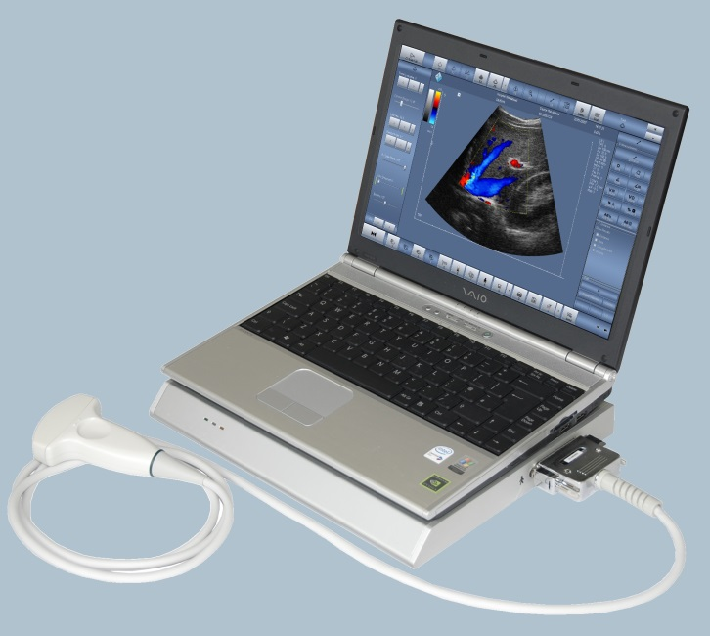
PC-Based Software Driven Ultrasound Systems

Slide 2
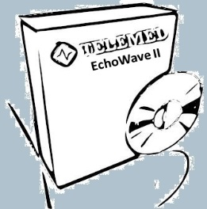
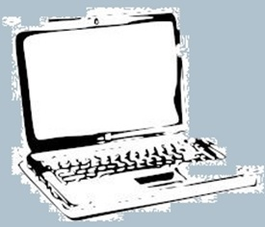
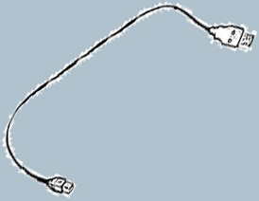
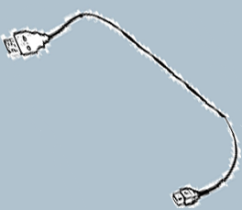
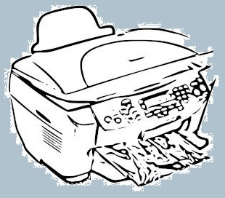
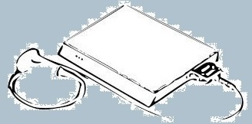
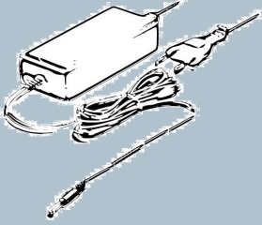
PC-based software driven Ultrasound Systems
Performance of traditional high standard ultrasound equipment
User friendly EchoWave II Software interface
Advanced Telemedicine Applications
Remote Control for Consult, Assistance and Training
Free Upgrades
No Obsolescence
Excellent quality-price ratio
…installed from
EchoWave II Sostware can be…
WEB
SERVER
…downloaded and installed from
Beamformer

Slide 3
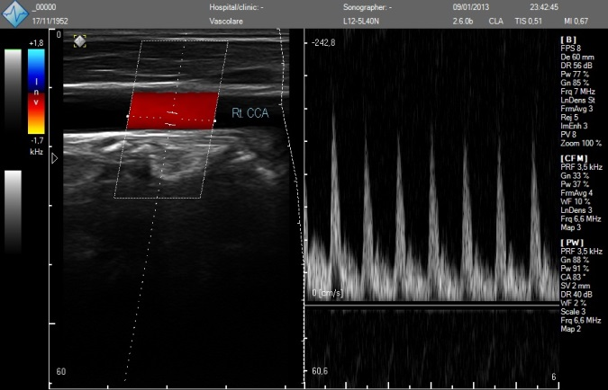
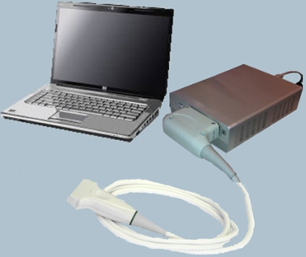
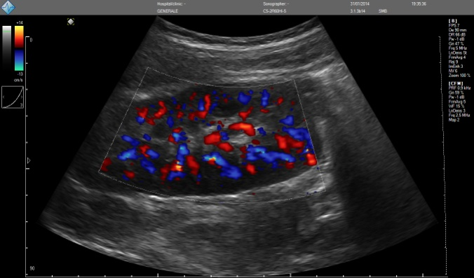
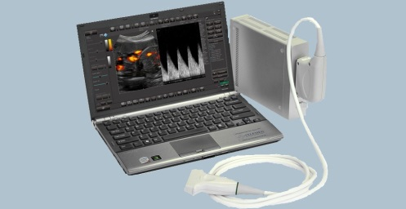
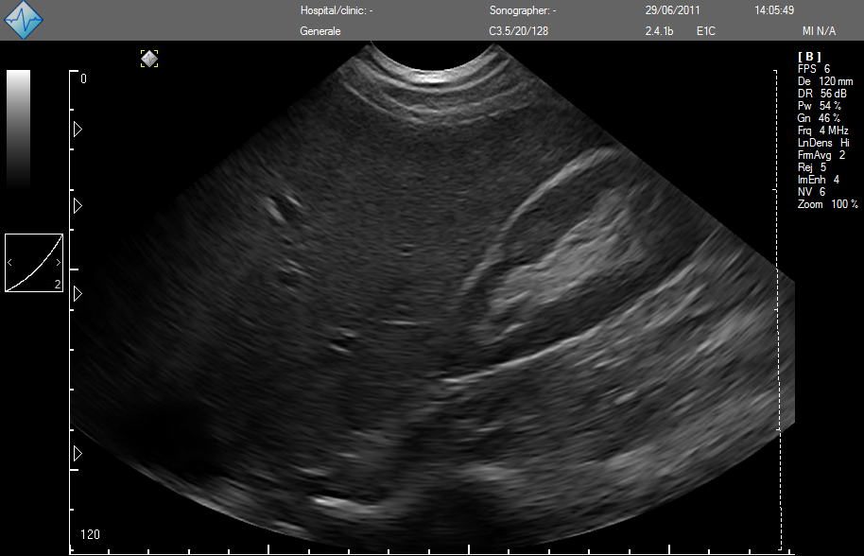
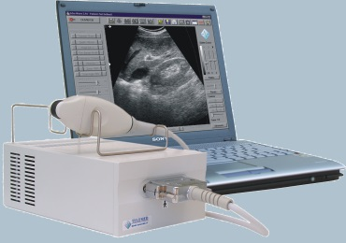
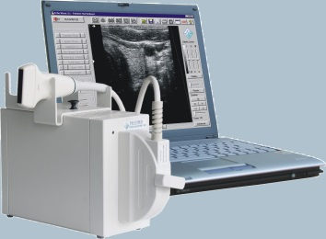
TELEMED Ultrasound Systems
Echo Color Doppler Scanner
LS 64
SmartUs
ClarUs Ext
EchoBlaster 64
EchoBlaster 128
B/W Scanner

Slide 4
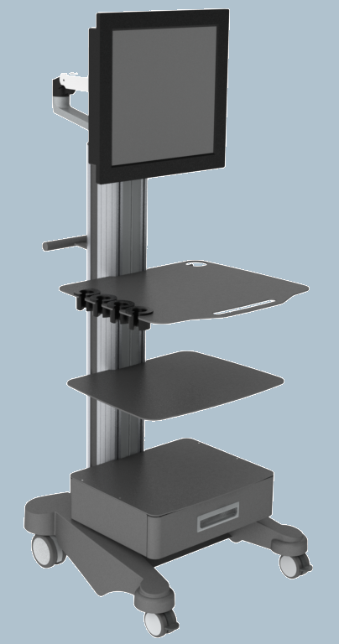
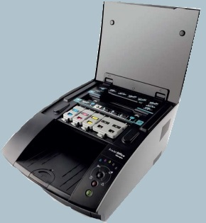
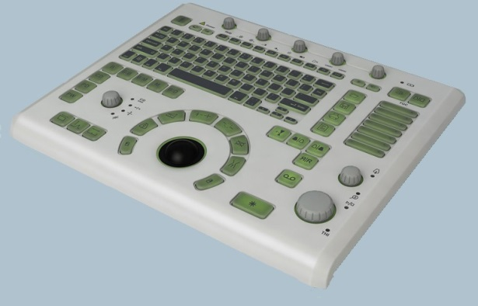
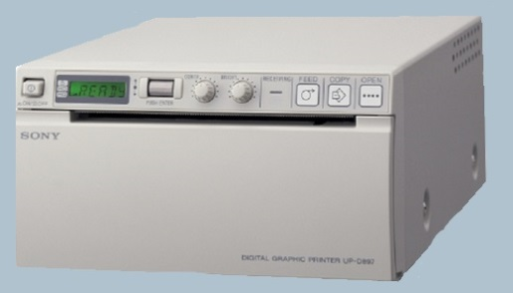
TELEMED Accessories
CART
PRINTERS
ULTRASOUND KEYBOARD
LB2 Ultrasound plug&play Consolle
Lomond Evojet
TELEMED Column Cart
Sony UP-D897 B/W

Slide 5
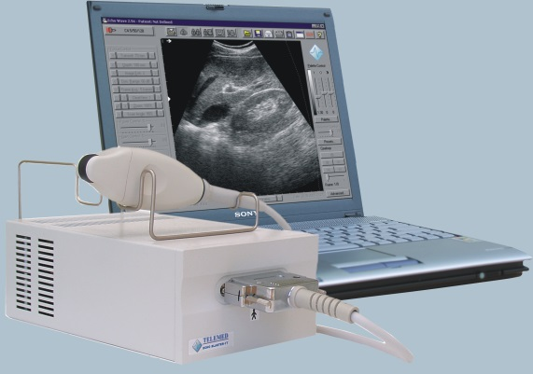
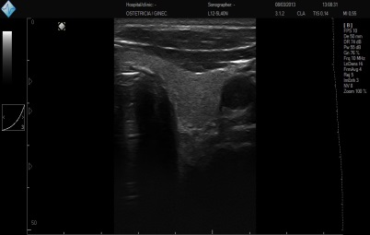
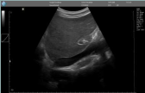
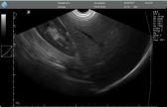
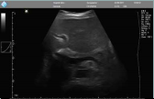
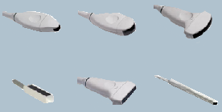
Echo Blaster 64 -
B/W System
GENERAL SPECIFICATIONS
Applications
• Abdomen, OB/Gyn, urology, andrology, muscle-skeletal, surgery, cardiology,
primary care, vascular access, anesthesia
Imaging Modes
• B, 2B, 4B, BM, M, Zoom
Transducers
• Linear, Convex, Intracavitary probes
• Frequency range 2 > 8 MHz
• Multifrequency
• Automatic transducer recognition
System architecture
• PC-based software driven architecture,
USB connection to PC
• High-speed software image processing
• NeatView speckle reduction imaging
Ultrasound Software
• Echo Wave II software (Windows XP/ 7 / 8
32-64 bit)
• Free upgrade via the Internet
Power
• 100~240 VAC, 50~60 Hz AD
Dimensions, weight
• 14.5 cm (W) x 22.5 cm (L) x 12.6 cm (H)
2.3 kg
General measurements
• B-mode: distance, length, circumference, area, volume, angle, stenosis %
• M-mode: distance, time, velocity, heart rate, stenosis %
Calculation packages
• Human: obstetrics, gynecology, urology, abdominal, endocrinology, vascular, cardiology
Functions
• Mouse / trackball / keyboard operation
• Unlimited programmable presets for clinically specific imaging
• Multilanguage
• Customizable user interface
• Printing to system printer
Cine loop and image store
• Recording thousands of frames
• Storing ultrasound video file to a disk
• Loading ultrasound video file from a disk
• Review, processing and measurements available on stored images and cine loops
• AVI, JPG, DICOM and other popular formats support
• Raw data images and video
PV6.5/10/64D
C3.5/20/64D
C3.5/60/64D
PROBES
Type Frequency Scanning Field of View Applications
(MHz) Method Degree/mm
C3.5/20/64D 2.0-4.0 Convex R20 104° Abdominal, Cardiac
C3.5/60/64D 3.0-5.0 Convex R60 59° Abdominal, Ob./Gyn., Pediatrics
PV6.5/10/64D 5.0-7.5 Convex R10 147° Small Parts, Vascular, Veterinary
LV7.5/65/64D
HL9.0/40/64D
EC6.5/10/64D
HL9.0/40/64D 5.0-8.0 Linear 40 mm 39 mm Small Parts, Vasc., Vet., Pediatrics
LV7.5/65/64D 4.5-7.5 Linear 65 mm 63 mm Veterinary
EC6.5/10/64D 5.0-8.0 Convex R10 147° Transvaginal, Transrectal

Slide 6
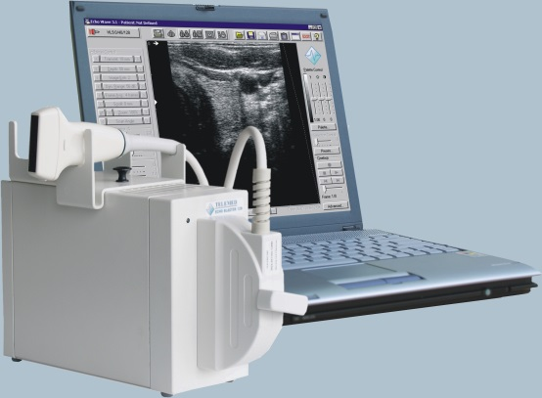
Echo Blaster 128 -
B/W System
GENERAL SPECIFICATIONS
Applications
• Abdomen, OB/Gyn, urology, andrology, muscle-skeletal, surgery, cardiology,
primary care, vascular access, anesthesia
Imaging Modes
• B, 2B, 4B, BM, M, Zoom
Transducers
• Linear, Convex, Intracavitary probes
• Frequency range 2 > 10 MHz
• Multifrequency
• Automatic transducer recognition
System architecture
• PC-based software driven architecture,
USB connection to PC
• High-speed software image processing
• NeatView speckle reduction imaging
Ultrasound Software
• Echo Wave II software (Windows XP/ 7 / 8
32-64 bit)
• Free upgrade via the Internet
Power
• 100~240 VAC, 50~60 Hz AD
Dimensions, weight
• 14.5 cm (W) x 22.5 cm (L) x 12.6 cm (H)
2.3 kg
General measurements
• B-mode: distance, length, circumference, area, volume, angle, stenosis %
• M-mode: distance, time, velocity, heart rate, stenosis %
Calculation packages
• Human: obstetrics, gynecology, urology, abdominal, endocrinology, vascular, cardiology
Functions
• Mouse / trackball / keyboard operation
• Unlimited programmable presets for clinically specific imaging
• Multilanguage
• Customizable user interface
• Printing to system printer
Cine loop and image store
• Recording thousands of frames
• Storing ultrasound video file to a disk
• Loading ultrasound video file from a disk
• Review, processing and measurements available on stored images and cine loops
• AVI, JPG, DICOM and other popular formats support
• Raw data images and video
PV6.5/10/128Z
C3.5/20/128Z
C3.5/60/128Z
PROBES
Type Frequency Scanning Field of View Applications
(MHz) Method Degree/mm
C3.5/60/128Z 2.0-5.0 Convex R60 65° Abdominal, Ob./Gyn., Pediatrics
C4.5/50/128Z-2 3.0-7.0 Convex R50 70° Abdominal, Ob./Gyn., Pediatrics
PV6.5/10/128Z 5.0-8.0 Convex R10 156° Small Parts, Vascular, Pediatrics
C3.5/20/128Z 2.0-4.0 Convex R20 104° Abdominal, Cardiac
LV7.5/60/128Z
HL9.0/40/128Z
EC6.5/10/128Z
HL9.0/40/128Z 5.0-10.0 Linear 40 mm 39 mm Small Parts, Vascular, MSK
HL9.0/60/128Z 5.0-10.0 Linear 60 mm 59 mm Small Parts, Vascular, MSK
LV7.5/65/128Z 4.5-7.5 Linear 60 mm 59 mm Small Parts
EC6.5/10/128Z 5.0-8.0 Convex R10 147° Transvaginal, Transrectal

Slide 7
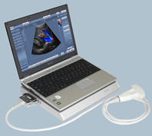
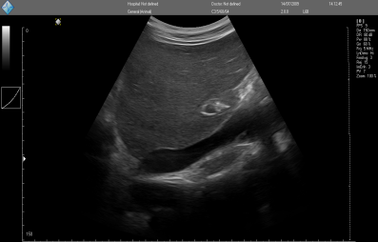
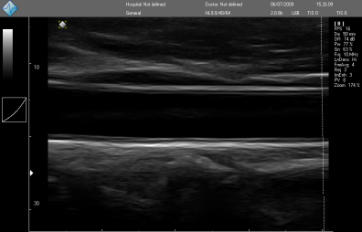
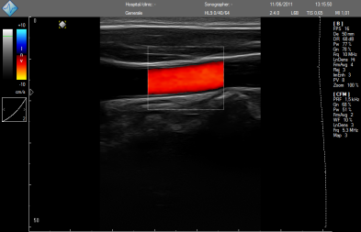
LS 64 -
Echo Color Doppler System
GENERAL SPECIFICATIONS
Applications
• Abdomen, OB/Gyn, urology, andrology,
vascular, muscle-skeletal, surgery, cardiology
primary care, vascular access, anesthesia
Imaging Modes
• B, 2B, 4B, BM, M, Zoom
• Color Doppler, Power/Directional power, Spectral Doppler, Duplex, Triplex, HPRF
• Thumbnails
Transducers
• Linear, Convex, Intracavitary probes
• Frequency range 2 > 10 MHz
• Multifrequency, wide bandwidth,
• Automatic transducer recognition
• 2 probe connectors
System architecture
• PC-based software driven architecture,
USB connection to PC
• High-speed software image processing
• NeatView speckle reduction imaging
Ultrasound Software
• Echo Wave II software (Windows XP/ 7 / 8
32-64 bit
• Free upgrade via the Internet
Power
• 90~240 VAC, 50~60 Hz AD
Dimensions, weight
• 31.5 cm (W) x 25 cm (L) x 3 cm (H)-2.3 kg
General measurements
• B-mode: distance, length, circumference, area, volume, angle, stenosis %
• M-mode: distance, time, velocity, heart rate, stenosis %
• Spectral Doppler: velocity,PG, PI and etc.
• Automatic tracing and calculations in real-time, Freeze modes and on stored images
Calculation packages
• Human: obstetrics, gynecology, urology, abdominal, endocrinology, vascular, cardiology
Functions
• Mouse / trackball / keyboard operation
• Unlimited programmable presets for clinically specific imaging
• Multilanguage
• Customizable user interface
• Printing to system printer
Cine loop and image store
• Recording thousands of frames
• Storing ultrasound video file to a disk
• Loading ultrasound video file from a disk
• Review, processing and measurements available on stored images and cine loops
• AVI, JPG, DICOM and other popular formats support
• Raw data images and video
PV6.5/10/64D
C3.5/20/64D
C3.5/60/64D
PROBES
Type Frequency Scanning Field of View Applications
(MHz) Method Degree/mm
LV7.5/65/64D
HL9.0/40/64D
EC6.5/10/64D
C3.5/20/64D 2.0-4.0 Convex R20 104° Abdominal, Cardiac
C3.5/60/64D 2.0-5.0 Convex R60 59° Abdominal, ./Ob., Pediatrics
PV6.5/10/64D 5.0-8.0 Convex R10 156° Small Parts, Vascular, Veterinary
HL9.0/40/64D-3 5.0-10.0 Linear 40 mm 39 mm Small Parts, Vasc., MSK, Pediatrics
EC6.5/10/64D-3 5.0-8.0 Convex R10 147° Transvaginal, Transrectal

Slide 8
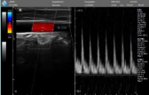
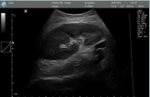
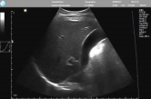
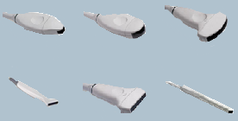
ClarUs EXT-
Echo Color Doppler System
GENERAL SPECIFICATIONS
Applications
• Abdomen, OB/Gyn, urology, andrology,
vascular, muscle-skeletal, surgery, cardiology
primary care, vascular access, anesthesia
Imaging Modes
• B, 2B, 4B, BM, M, Zoom, THI, B-Steer,
compound, trapezoid
• Color Doppler, Power/Directional power, Spectral Doppler, Duplex, Triplex, HPRF
• Thumbnails
Transducers
• Linear, Convex, Intracavitary probes
• Frequency range 2 > 15 MHz
• Multifrequency, wide bandwidth,
• Automatic transducer recognition
System architecture
• PC-based software driven architecture,
USB connection to PC
• High-speed software image processing
• NeatView speckle reduction imaging
Ultrasound Software
• Echo Wave II software (Windows XP/ 7 / 8
32-64 bit
• Free upgrade via the Internet
Power
• 100~240 VAC, 50~60 Hz AD,
Dimensions, weight
• 21.5cm (L) x 16.5 cm (W) x4.5 cm (H)-1.3 kg
General measurements
• B-mode: distance, length, circumference, area, volume, angle, stenosis %
• M-mode: distance, time, velocity, heart rate, stenosis %
• PW Spectral Doppler: velocity,PG, PI and etc.
• PW Automatic tracing and calculations in real-time, Freeze modes and on stored images
Calculation packages
• Human: obstetrics, gynecology, urology, abdominal, endocrinology, vascular, cardiology
Computer Configuration
• Desktop, notebook or tablet
• CPU i3/i5/i7 1,8 GHz - 1 Gb RAM or better
• O.S. Windows XP / Vista / 7 / 8 (32-64 bit)
Functions
• Mouse / trackball / keyboard operation
• Unlimited programmable presets for clinically specific imaging
• Multilanguage
• Customizable user interface
• Printing to system printer
Cine loop and image store
• Recording thousands of frames
• Storing ultrasound video file to a disk
• Loading ultrasound video file from a disk
• Review, processing and measurements available on stored images and cine loops
• AVI, JPG, DICOM and other popular formats support - Raw data images and video
MC10-5R10N
MC4-2R20N
C7-3R50N
PROBES
Type Frequency Scanning Field of View Applications
(MHz) Method Degree/mm
L15-7L25N
L12-5L40N
MCV9-5R10N
C7-3R50N -2 3.0-7.0 Convex R50 70° Abdominal, Ob./Gyn., Pediatrics
C5-2R60N 2.0-5.0 Convex R60 65° Abdominal, Ob./Gyn., Pediatrics
MC10-5R10N 5.0-8.0 Convex R10 156° Small Parts, Vascular, Pediatrics
MC4-2R20N 2.0-4.0 Convex R20 104° Abdominal, Cardiology
L12-5L40N-4 5.0-12.0 Linear 40 mm 39 mm Small Parts, Vascular, MSK
L12-5L60N 5.0-12.0 Linear 60 mm 59 mm Small Parts, Vascular, MSK
L15-7L25N 7.0/14.0 Linear 25 mm 25 mm Small Parts, Intraoperative
MCV9-5R10N 5.0-8.0 Convex R10 147° Transvaginal, Transrectal

Slide 9
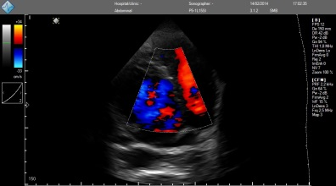
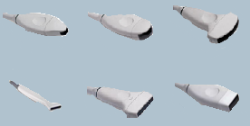
SmartUs -
Echo Color Doppler System
GENERAL SPECIFICATIONS
Applications
• Abdomen, OB/Gyn, urology, andrology,
vascular, muscle-skeletal, surgery, cardiology
primary care, vascular access, anesthesia
Imaging Modes
• B, 2B, 4B, BM, M, Zoom, THI, B-Steer,
compound, trapezoid
• Color Doppler, PowerDoppler, Directional Power Doppler, PW-CW Spectral Doppler, Duplex, Triplex, HPRF
• 3D View, Panoramic View (Optional)
Transducers
• Linear, Convex, Sector Phased Array , Intracavitary probes
• Frequency range 1.8 > 18 MHz
• Multifrequency, wide bandwidth,
• Automatic transducer recognition
System architecture
• PC-based software driven architecture,
USB connection to PC
• High-speed software image processing
• NeatView speckle reduction imaging
Ultrasound Software
• Echo Wave II software (Windows XP/ 7 / 8
32-64 bit
• Free upgrade via the Internet
Power
• 100~240 VAC, 50~60 Hz AD,
Dimensions, weight
• 21.5cm (L) x 16.5 cm (W) x4.5 cm (H)-1.4 kg
General measurements
• B-mode: distance, length, circumference, area, volume, angle, stenosis %
• M-mode: distance, time, velocity, heart rate, stenosis %
• PW-CW Spectral Doppler: velocity,PG, PI and etc.
• PW-CW Automatic tracing and calculations in real-time, Freeze modes and on stored images
Calculation packages
• Human: obstetrics, gynecology, urology, abdominal, endocrinology, vascular, cardiology
Computer Configuration
• Desktop, notebook or tablet
• CPU i3/i5/i7 1,8 GHz - 1 Gb RAM or better
• O.S. Windows XP / Vista / 7 / 8 (32-64 bit)
Functions
• Mouse / trackball / keyboard operation
• Unlimited programmable presets for clinically specific imaging
• Multilanguage
• Customizable user interface
• Printing to system printer
Cine loop and image store
• Recording thousands of frames
• Storing ultrasound video file to a disk
• Loading ultrasound video file from a disk
• Review, processing and measurements available
on stored images and cine loops
• AVI, JPG, DICOM and other popular formats support - Raw data images and video
MC10-5R10N
MC4-2R20N
C5-2R60HI
PROBES
Type Frequency Scanning Field of View Applications
(MHz) Method Degree/mm
C7-3R50HI -2 3.0-7.0 HD Convex R50 70° Abdominal, Ob./Gyn., Pediatrics
C5-2R60HI 2.0-5.0 HD Convex R50 65° Abdominal, Ob./Gyn., Pediatrics
C7-3R50N-2 5.0-8.0 Convex R10 70° Small Parts, Vascular, Pediatrics
C5-2R60N 2.0-4.0 Convex R20 104° Abdominal, Cardiology
L15-7L25N
L15-7L40HI
P5-1L15SI
L12-5L40HI 5.0-12.0 HD Linear 40 mm 39 mm Small Parts, Vascular, MSK
L12-5LN-4 5.0-12.0 Linear 60 mm 59 mm Small Parts, Vascular, MSK
L15-7L40HI 7.0/14.0 HD Linear 25 mm 25 mm Small Parts, Neurology
P5-1L156SI 1.8-5.0 Electronic sectoral 90° Cardiac, Transcranical
MCV9-5R10N 5.0-8.0 Convex R10 147° Transvaginal, Transrectal

Slide 10
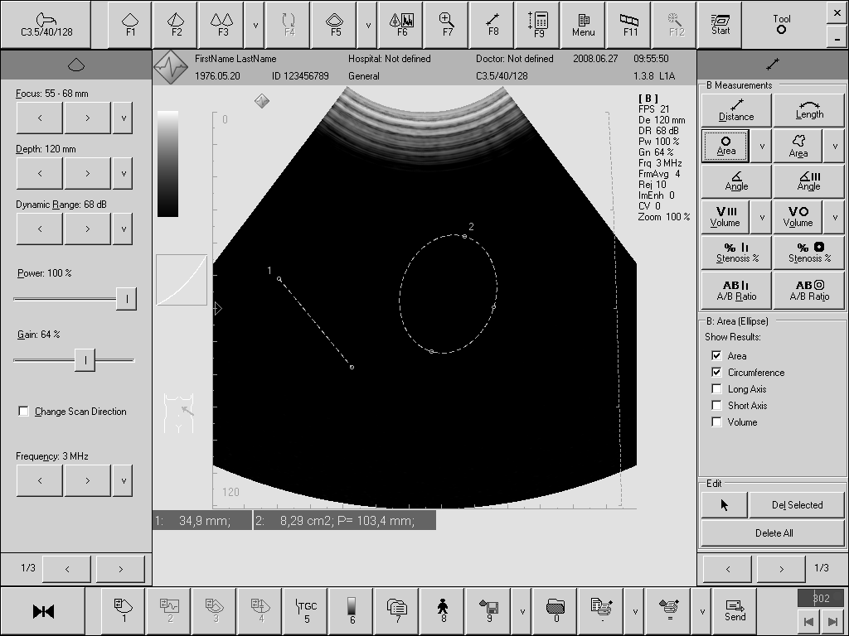
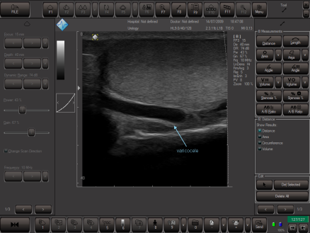
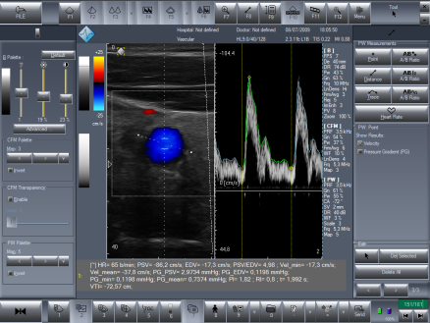
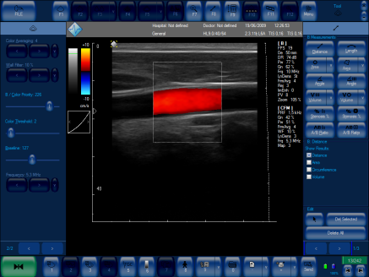
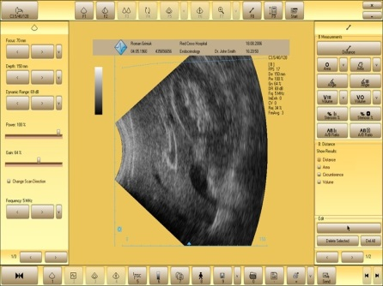
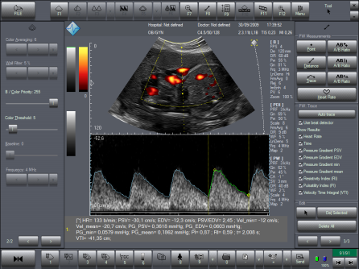
EchoWave II -
TELEMED Software
TELEMED EWII INTERFACE
User friendly
Easy to customize
Flexible and configurable for any computer, resolution, application
SKINIZATION TECHNOLOGY

Slide 11
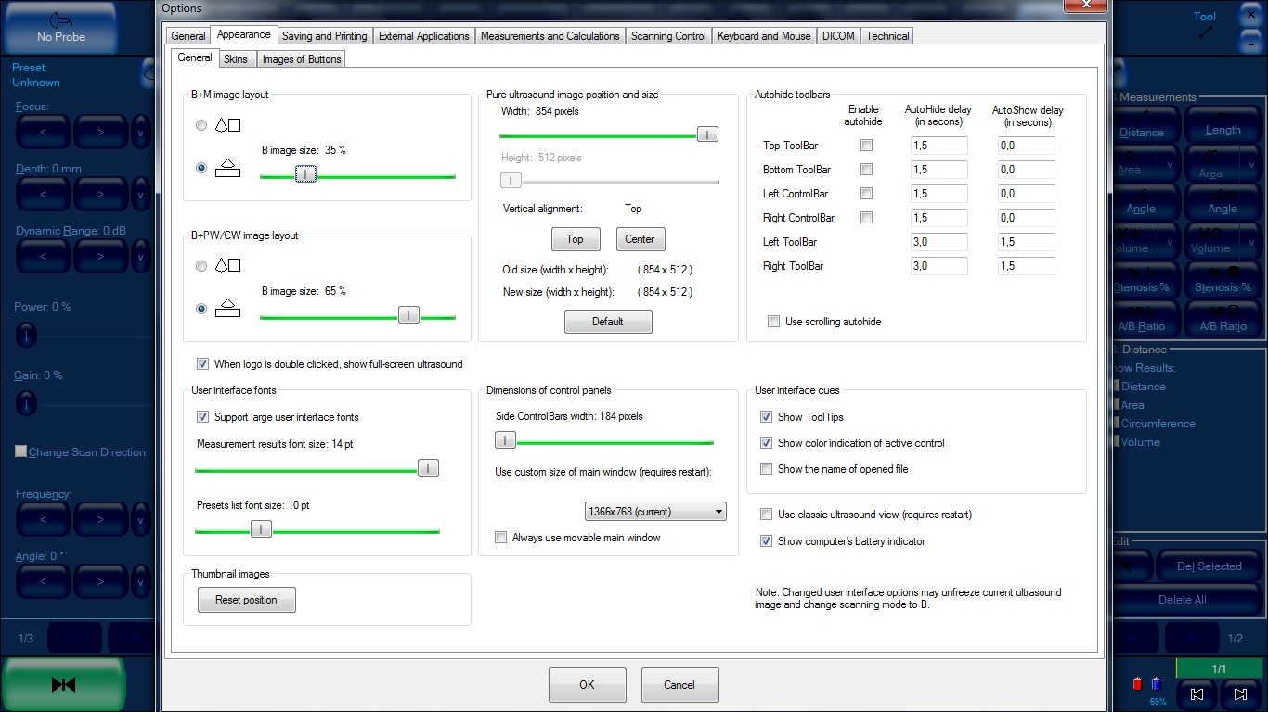
EchoWave II -
TELEMED Software
General Tools Configuration:
Ultrasound Window Size
Combined Modes (B+M B+PW/CW) layout
Fonts and Control Panels size
Autohide Time Toolbars
Presets List Font Size
User Interface Resolution

Slide 12
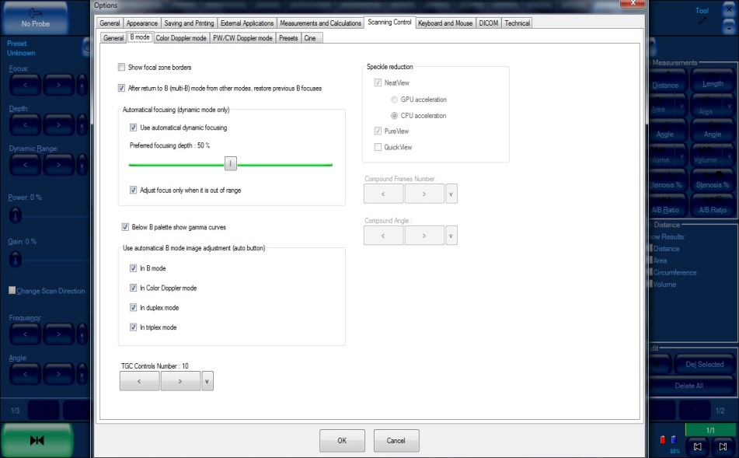
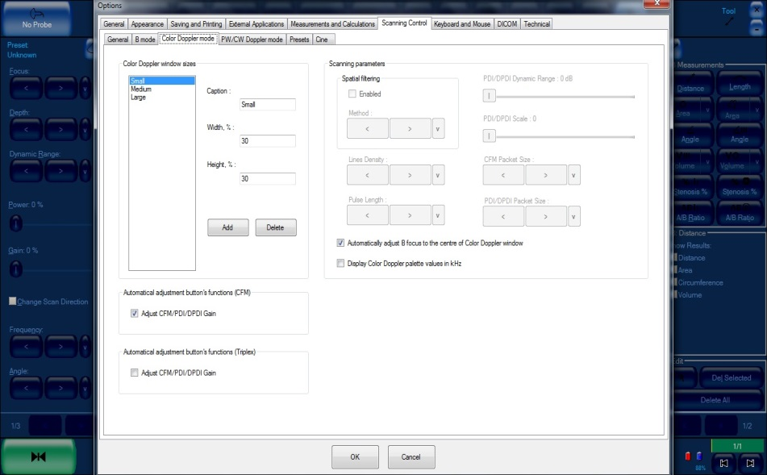
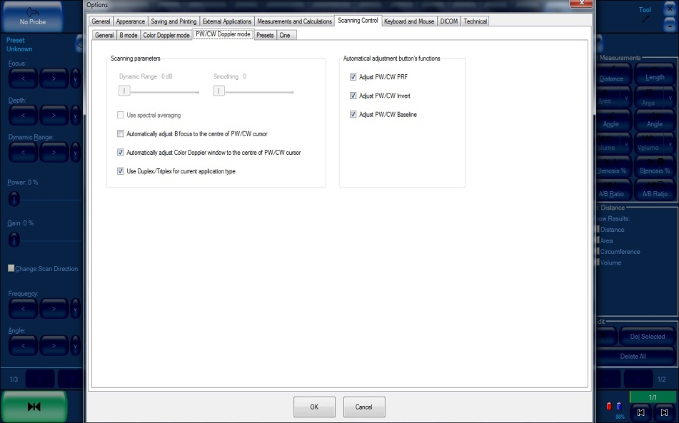
EchoWave II -
TELEMED Software
B Mode Tools Configuration:
Speckle Reduction Imaging
Automatical Focusing
Automatical Image Adjustment
Color Doppler Mode Tools Configuration:
Window Size
Lines Density
Pulse length
CFM/PDI/DPDI Packet Size
PW/CW Doppler Mode Tools Configuration:
Duplex/Triplex Use
PW/CW PRF Adjustment
PW/CW Invert Adjustment
PW/CW Baseline Adjustment

Slide 13
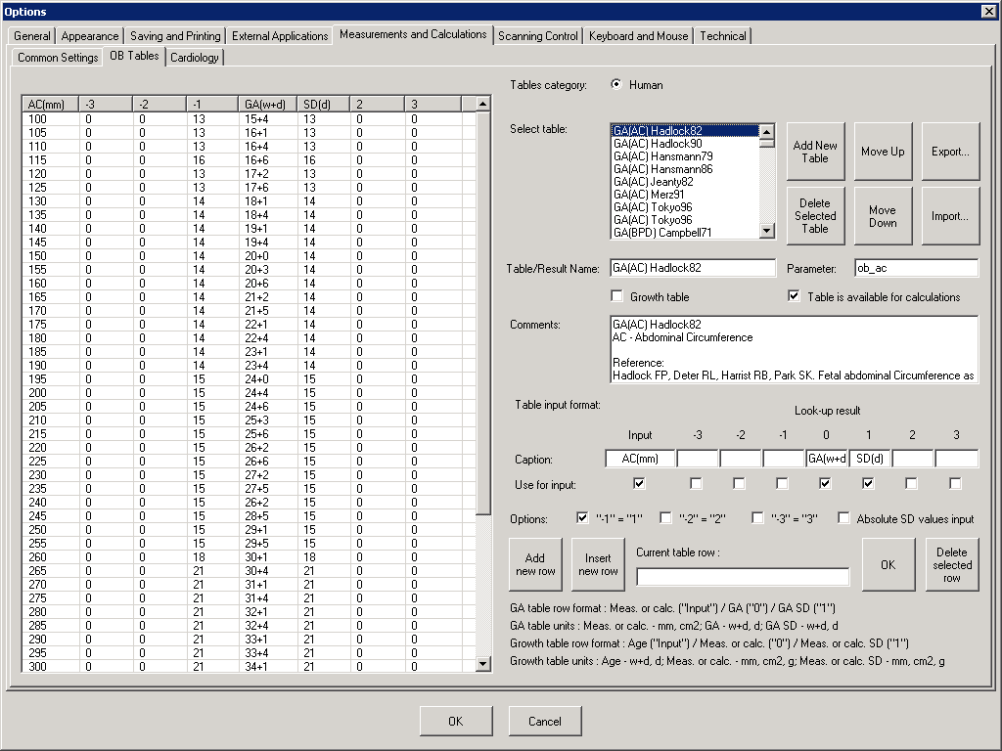
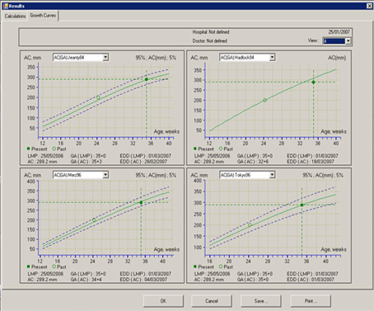
EchoWave II -
TELEMED Software
Measurements and calculations:
Extensive human and vet calculations packages
Editable tables
Fetal growth tables

Slide 14
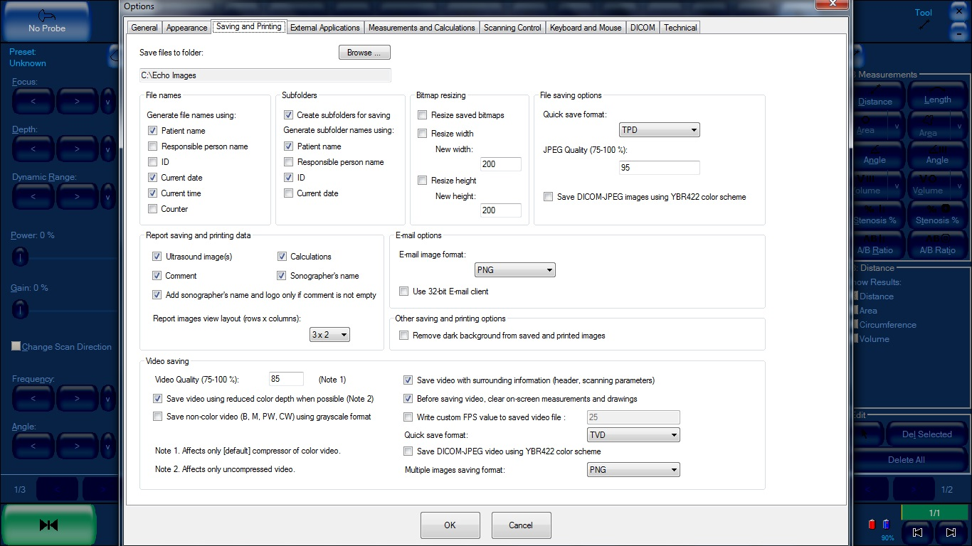
EchoWave II -
TELEMED Software
Saving and Printing Tools Configuration:
Save as bmp, jpg, tif, png, dicom, dicom-jpeg, avi files + tpd and tvd row data
File names configuration
Subfolders configuration
Report configuration
Background removal for printing
…and more

Slide 15
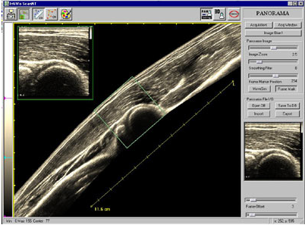
TELEMED Optional software
3D Pano View

Slide 16
TELEMED Optional software
3D View

Slide 17
TELEMED Technical Assistance and Support with System Remote Control
NETWORK
Training
Distributor
Customer
Technical Support
System Customization
Backup of Presets
Latest Software Upgrades Installation
System Errors Identification
Diagnosis and Troubleshooting
Immediate On-line Reparation
Telemedicine
Didactics
TELEMED
CUSTOMER

Slide 18
TELEMED System Remote Control
TRAINING
How to Install the System
How to Install EchoWave II Software and Drivers
TO DISTRIBUTORS
Scanning Modalities
Overview of EchoWave II User Interface
Scanning Controls
Measurements
Calculations
How To Change Some Default Options
Import
How To Manage Presets
Export
Backup
Images (jpg, bmp, png, tif, Dicom, TPD)
How To Save
TO CUSTOMERS
Video (avi, png multiple images, Dicom, TVD)
How To Start an Exam
How To Manage Patient Information
How To Create a report, Direct e-mail or Print

Slide 19
TELEMED System Remote Control
TECHNICAL SUPPORT
EchoWave II Interface Customization
Latest Software Upgrades Installation
NETWORK
Diagnosis and Troubleshooting
TELEMED
CUSTOMER
Backup of User Settings (Option, Presets…)

Slide 20
TELEMED System Remote Control
TELEMEDICINE

Slide 21
TELEMED System Remote Control
DIDACTICS
TELEMED Technical and Training applications using System remote control
Every student can download EchoWave II software, images and video on own PC
NETWORK
TELEMED
UNIVERSITY

Slide 22
TELEMED Ultrasound System
Modular Solution
Easy to Carry
Lightweight
ADVANTAGES
Easy to be managed…
Easy to Use
… also with SmartPhone

